Slide 1
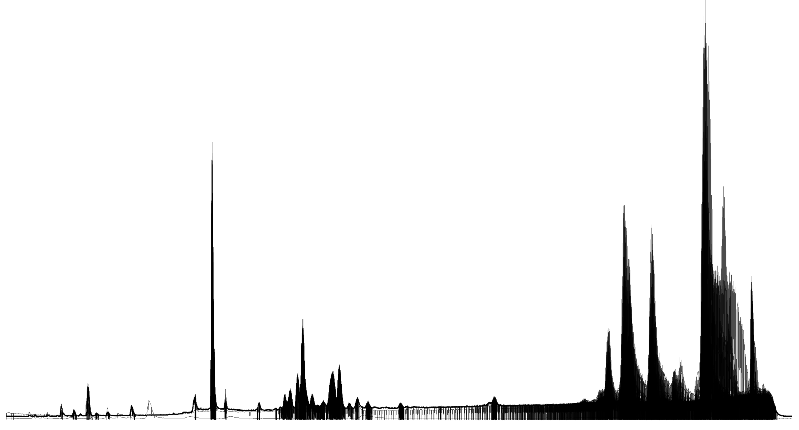
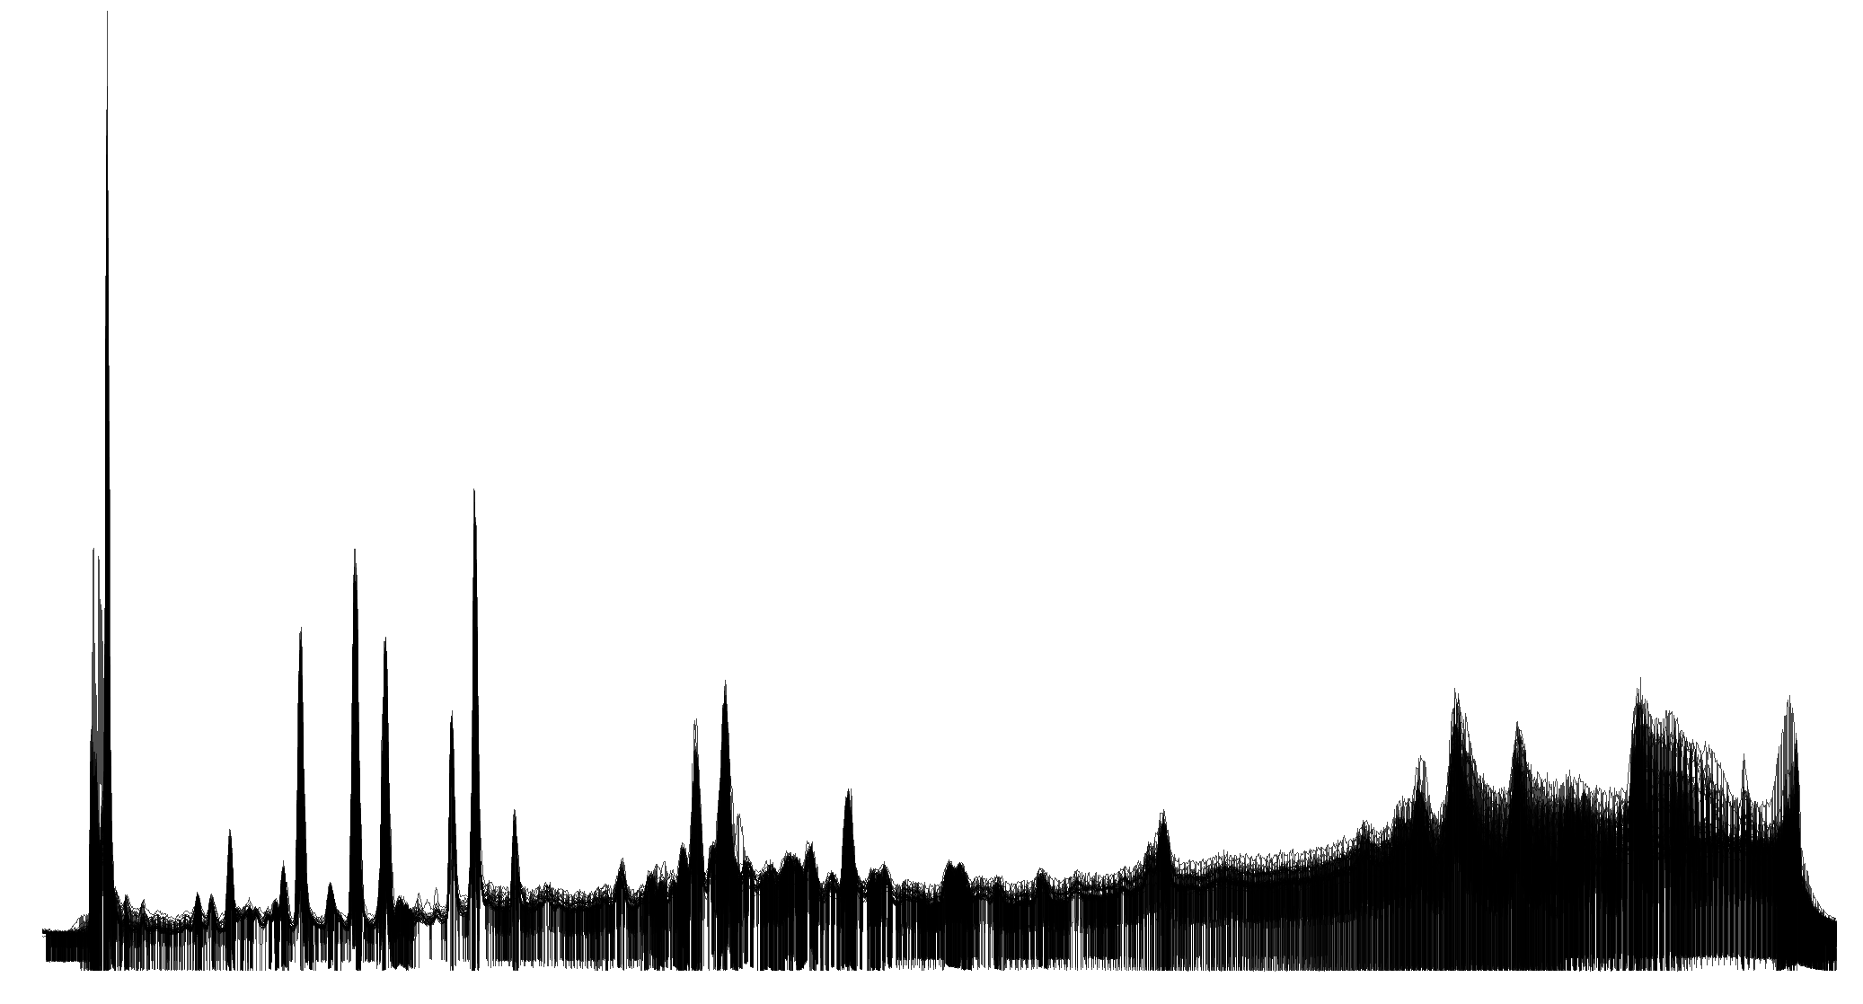
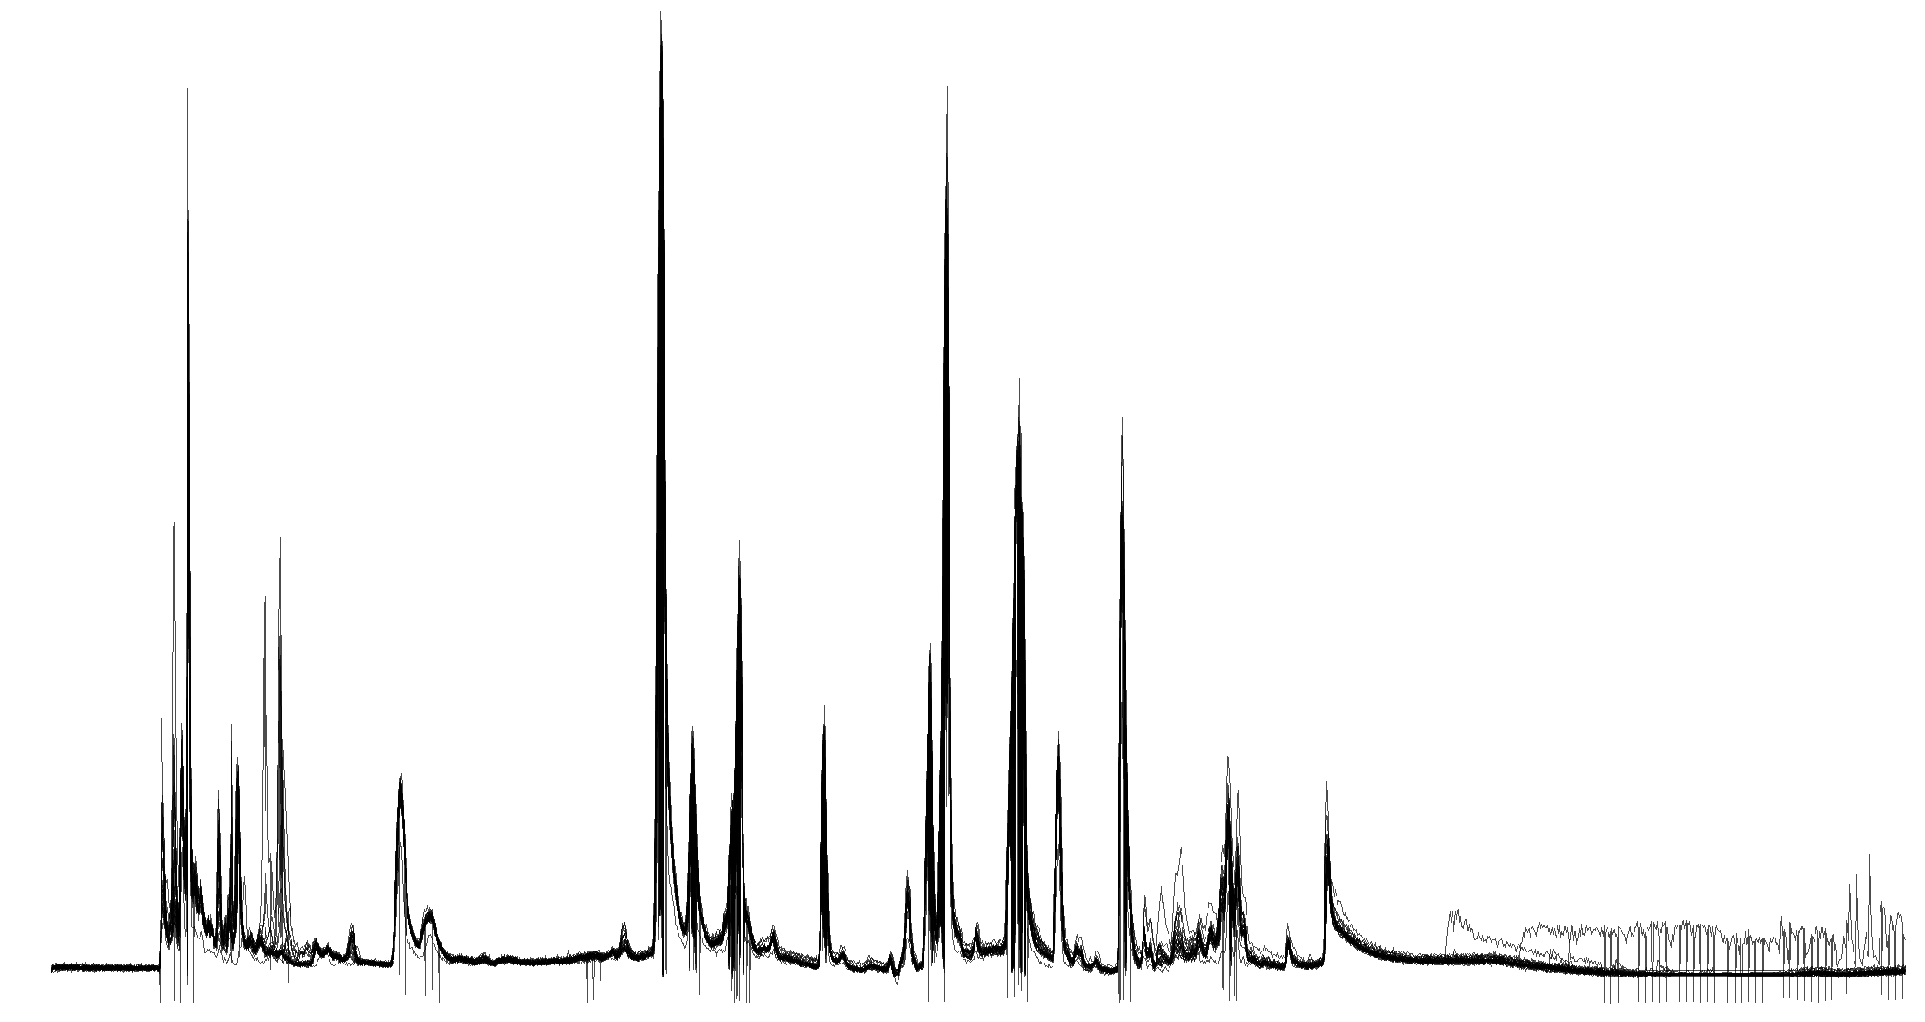
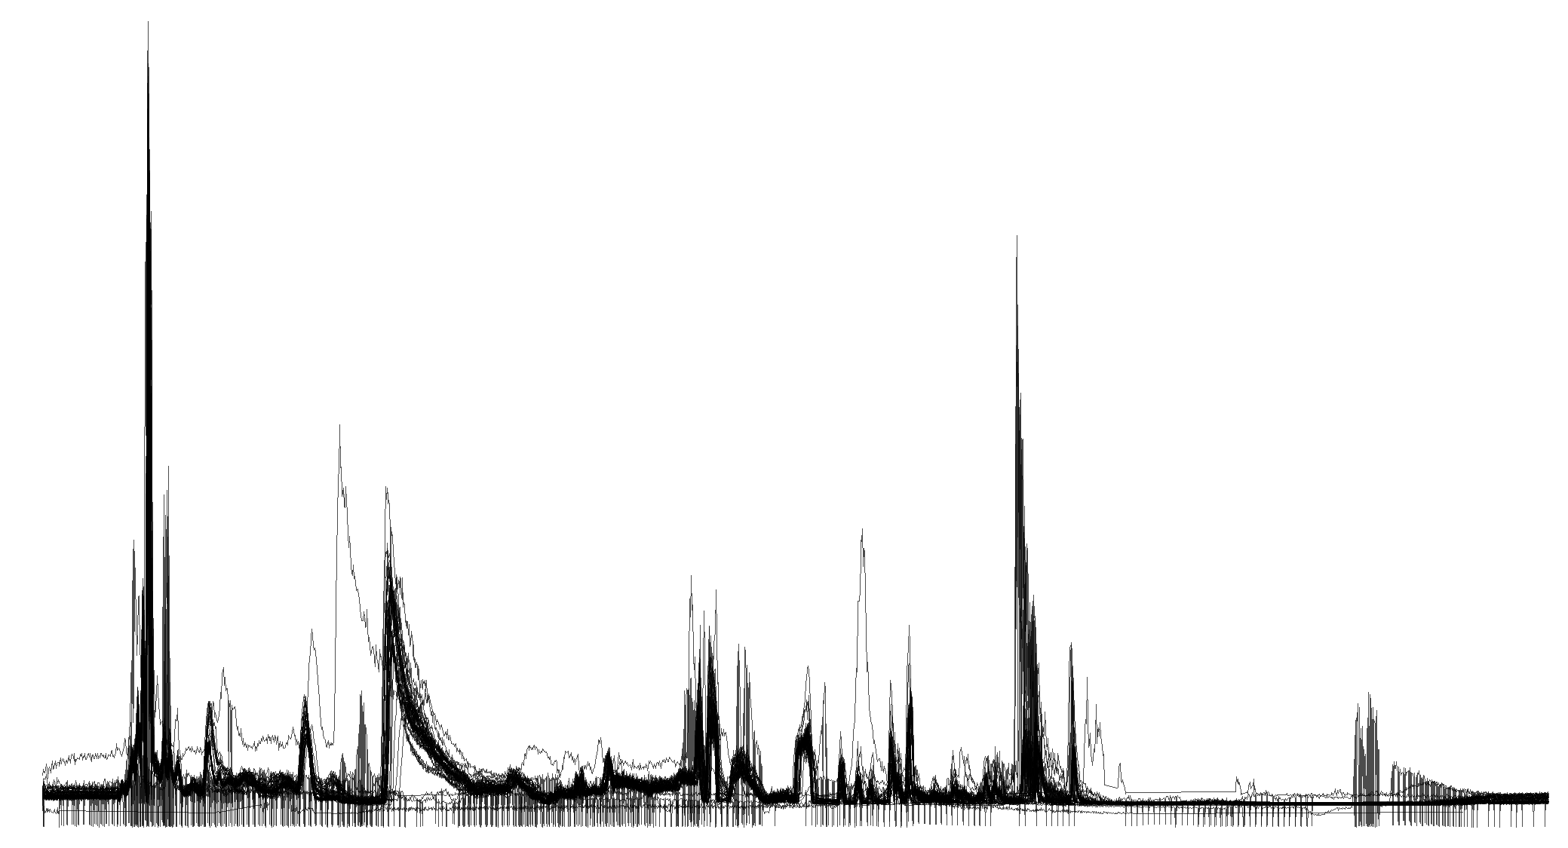
CSH - POS
CSH - NEG
Intensity
HILIC - POS
HILIC - NEG
Retention time
Supplemental Figure S1. Overlaying total ion chromatograms for 20 BioIVT human plasma quality control samples that were analyzed after every ten samples within a batch of 200 samples. Except HILIC-NEG, no major drift in the total signal was observed.

